Slide 1
Health apps
By Preeti Moda

Slide 2
What health apps do?
Helps in following proper diet and exercise
Can track Blood pressure,check eye sight
Helps in maintaining records in hospitals
Can signal doctors if a patient’s condition changes

Slide 3
App 1:Weight watchers
Recipes
Tracker menu
Restaurant guide
Find menu
Calculator menu
Grocery helper
Provides video demos for fitness exercises
Meeting locator(additional feature)

Slide 4
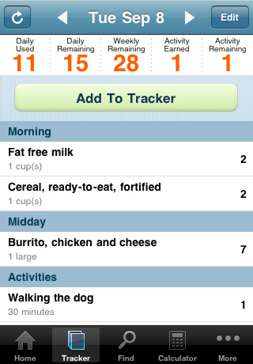
Tracking points for food and activities

Slide 5
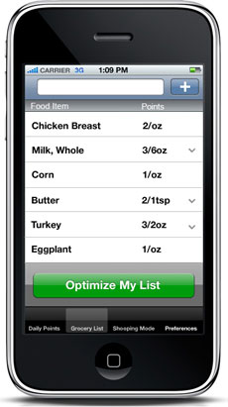
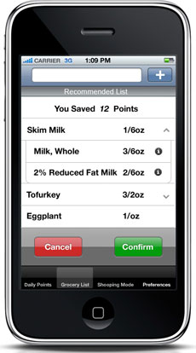
Grocery helper for weight watcher app

Slide 6

What makes it a better app and a knowledge advantage machine
Intelligence
Computation
Connectivity

Slide 7
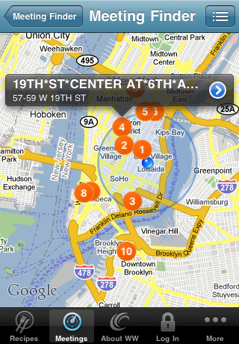
Connectivity
Connects to weight watchers
website and sets meetings
to obtain latest information
or helps to follow the
meetings online

Slide 8
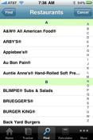
connectivity
Helps in locating the
restaurants and pulls out
required information

Slide 9
Computation
Computes the points for specific food
Computes daily and weekly points and also activity points
Displays progress charts showing our progress

Slide 10
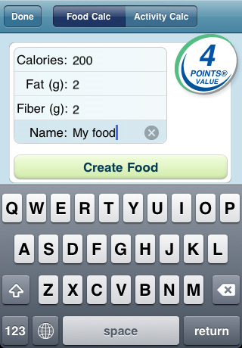
Computing the points for food in weight watchers app

Slide 11
Intelligence
Suggests the food available in the specified restaurant depending on the preferences
Grocery helper feature helps in selecting groceries by computing the points for each item and suggesting the better food item

Slide 12
App 2:Weight tracker -features
Keeps track of weight on a daily basis
Helps in setting goals and quantify progress toward goals

Slide 13
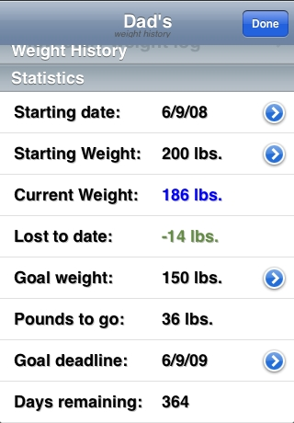
Weight history-profile overview

Slide 14
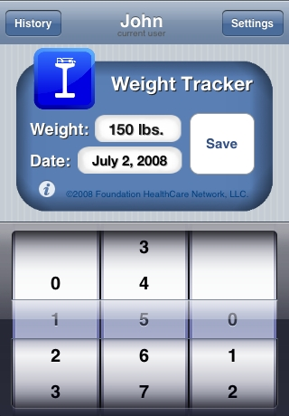
Weight entry in weight tracker

Slide 15
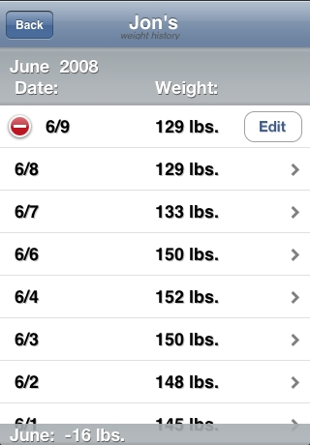
Weight journal in weight tracker

Slide 16
Computation in weight tracker
It computes the moving average along with scale weight
It develops a weight chart

Slide 17
Connectivity in weight tracker
Weight tracker connects to web so that they can maintain information online
Can login to the account in the webpage through the phone and update the information automatically

Slide 18
intelligence??????
NO intelligence in this application

Slide 19
Which app is better between the two?
Weight watcher is better than the weight tracker app as it has more features and has little intelligence compared to weight tracker

Slide 20
What can be added to weight watcher to make it a better app
We can add a GPS system which can locate the current position
We can also add a pedometer to track the steps we took per day and count the calories
These add more intelligence!

Slide 21
Few more apps!
Lifescan:
Connects to iphone through bluetooth enabled glucose monitor to find blood glucose levels for diabetes patients
In Korea, device maker LG has the KP8400, which is a cell phone that comes with a glucose monitoring strip, giving you insulin and blood readings on the phone’s display.

Slide 22
Few more apps
Hitachi of Japan offers a watch-like device that lets you track your pulse, skin-temperature and bodily motion.
Mobile phone based clinical microscopy for diagnosis,screening and monitoring of treatment of diseases like malaria etc

Slide 23
Any questions????

Slide 24
references
http://venturebeat.com/2009/04/21/your-health-on-the-iphone/
http://www.apple.com/webapps/utilities/weightdateweighttracker.html
http://www.weightwatchers.com/templates/marketing/Landing_1col_nonav.aspx?PageId=1144651
http://www.iphonelife.com/blog/2884/love-new-weightwatchers-app-0
http://appshopper.com/healthcare-fitness/weight-watchers-mobile
http://www.xuan-wang.com/portfolio/grocery.html
http://www.ehow.com/how_2058466_calculate-weight-watchers-points.html

